Slide 1


Sales & Operations Planning (S&OP) Review
Executive Business Performance, Inventory Health & Operational Alignment Strategy
Prepared For Executive Leadership Team
Period Q3 Operations Review
Focus Area Supply Chain & Logistics

Slide 2







Executive Summary
92.4%
6.4x
88.5%
84.2%
Forecast Accuracy
Inventory Turnover
Warehouse Capacity
Supplier On-Time SLA
+2.8% vs Q2
Target: 8.0x
High Fill Risk
-4.5% vs Target
Business Performance
Critical Operational Highlights
Order Fulfillment: Demand across key hardware sectors remained strong, driving a 6.2% QoQ revenue increase.
Networking Equipment Deficit: Stockout risks elevated in networking units due to component lead times.
Operational Resilience: Mitigated core regional supply bottlenecks through optimized re-routing.
Supplier SLA Disparity: Delayed POs increased lead times by an average of 4.2 days across tier-1 suppliers.
Service Levels: Customer delivery satisfaction reached 94.1% despite logistical delays.
Capacity Imbalance: Central distribution hubs operating at near peak limits requiring rebalancing.

Slide 3



Demand & Inventory Health
Demand Forecast vs. Actuals
Inventory Metrics & Health
Comparison of planned product units against actual market consumption for Q3.
Days of Supply (DOS): Averaging 42 days across portfolio (Target range: 35–40 days).
Enterprise Hardware96% Met (14,200 units)
Stockout Risks: Networking equipment safety stock levels fell below 8 days of threshold coverage.
Networking Equipment114% Surge (Stockout Risk)
Turnover Rate: Currently standing at 6.4x annually; requires targeted liquidations of legacy accessories.
Peripherals & Accessories88% Met (9,800 units)
Excess & Obsolete (E&O): E&O inventory held at 3.1% of total valuation, within acceptable parameters.
Cloud Infrastructure Units92% Met (7,400 units)
Key Insight: Unexpected 14% demand surge in networking hardware strained safety stocks, causing localized stockouts.

Slide 4
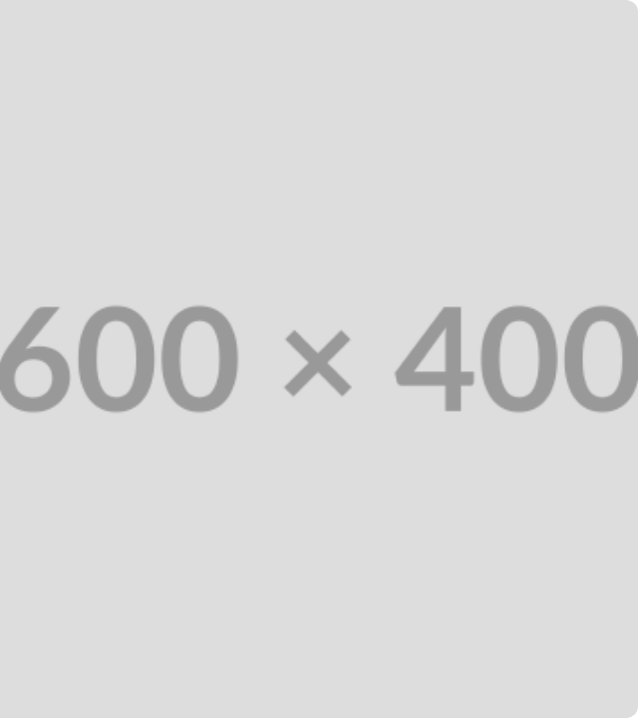


Warehouse Operations
Capacity & Distribution Analysis
High overall utilization is impacting picking speed and throughput efficiencies across primary regional hubs.
Central Distribution Hub94% Utilization
Eastern Region Facility82% Utilization
Western Region Facility71% Utilization
Operational Bottlenecks
Internal Transfers: Transfer lag between East and Central facilities increased to 3.5 days.
Inbound Processing: Dock-to-stock cycle times reached 18 hours during peak weeks.

Slide 5

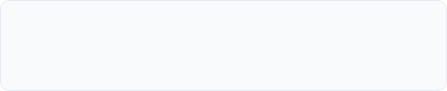
Supplier & Logistics
Vendor performance scorecards highlight lead time variance as the primary constraint on supply chain agility.
Supplier Category | On-Time Delivery | Lead Time Variance | Delayed PO Status | SLA Compliance
Tier-1 Semiconductors | 78% | +6.5 Days | 14 Active POs | Non-Compliant
Networking Chassis Mfrs | 82% | +4.0 Days | 8 Active POs | At Risk
Cable & Assembly Vendors | 94% | +1.2 Days | 2 Active POs | Compliant
Global Freight Logistics | 86% | +3.5 Days | 6 Shipments | At Risk
Transportation Delays
SLA Corrective Actions
Port congestion and customs clearance bottlenecks added an average of 3.5 days to inbound ocean shipments.
Initiated financial penalty enforcement for Tier-1 suppliers missing critical 90% OTD SLA benchmarks.

Slide 6







Executive Action Plan
Immediate Priorities
Medium-Term Actions
Success Metrics
Expedite Delayed POs: Authorize premium air freight for 14 delayed semiconductor orders.
Supplier Diversification: Qualify dual-source secondary vendors for high-risk component groups.
95.0%
Supplier On-Time Delivery SLA
Inventory Reallocation: Shift 15% stock from West facility to Central hub to relieve demand pressure.
Forecast Accuracy: Implement machine-learning demand modeling to reduce variance below 5%.
-30%
Reduction in Stockout Incidents
Networking Safety Stock: Increase minimum threshold by 20% for critical networking gear.
Capacity Optimization: Re-balance warehouse slotting layouts to boost picking efficiency by 18%.
8.0x
Inventory Turnover Target Next Quarter

